Slide 1
Gopichand Sujanmulk
Final Project
3/21/2024 Annual Review

Slide 2
KEY LOGGER & SECURITY
3/21/2024 Annual Review

Slide 3


AGENDA
Introduction
About keylogger and Security
Problem Statement
Project Overview
Who are the end users?
Your Solution and its Proposition
The Wow in Solution
Modelling
Result
Conclusion
My Project Link
3/21/2024 Annual Review

Slide 4

PROBLEM STATEMENT
There is a requirement for an easy-to-use application that can record keyboard activities accurately in real-time, addressing the complexity and cost issues associated with traditional keylogging software.
The application must include a straightforward graphical user interface (GUI) to allow users to start and stop the keylogging process effortlessly, making it accessible even for those with limited technical expertise.
The keylogger should serve as an educational tool demonstrating event handling and GUI integration in Python, with an emphasis on promoting ethical use and compliance with legal standards.
3/21/2024 Annual Review

Slide 5

PROJECT OVERVIEW
The project aims to develop a basic keylogger application with a graphical user interface (GUI) using Python. The keylogger will capture and log keyboard activities, providing real-time keystroke logging and saving the captured data in both text and JSON formats. The application is designed with a focus on simplicity, ease of use, and educational value, demonstrating how to integrate event handling, file operations, and GUI development in Python.
3/21/2024 Annual Review

Slide 6


WHO ARE THE END USERS?
Programming Students
Instructors
Security Analysts
Parents or Guardians
Researchers
System Administrators
Cyber criminals
Keyloggers are used in IT organizations to troubleshoot technical problems with computers and business networks
Families and business people uses keyloggers legally to monitor network usage without their users' direct knowledge
3/21/2024 Annual Review

Slide 7

YOUR SOLUTION AND ITS VALUE PROPOSITION
Solution:
The keylogger project provides a user-friendly application that captures and logs keystrokes in real-time, storing data in both text and JSON formats. It features a simple graphical user interface (GUI) for easy operation, making it accessible to users with varying technical expertise. The project serves as an educational tool for learning Python, demonstrating the integration of event handling, file operations, and GUI development. Emphasizing ethical use, it offers valuable applications for productivity monitoring, IT compliance, and controlled parental monitoring.
Value Proportion:
The keylogger project offers significant value by providing an easy-to-use interface for real-time keystroke logging, making it accessible even to non-technical users. It serves as a valuable educational tool, demonstrating practical Python applications and promoting ethical use. The project supports productivity tracking, IT compliance, and parental monitoring, addressing various user needs. Its open-source nature allows for customization and extension, catering to developers and contributors.
3/21/2024 Annual Review

Slide 8

THE WOW IN SOLUTION
The "wow" factor in the keylogger solution is that its combination of simplicity, educational value, and ethical focus. It provides an intuitive GUI that makes sophisticated keystroke logging accessible to all users, from beginners to advanced developers, without requiring deep technical knowledge. As an educational tool, it offers a practical example of integrating multiple Python libraries, demonstrating real-world applications of event handling, file operations, and GUI development. Moreover, by emphasizing ethical use, it sets a responsible standard for keylogging applications, ensuring that users are aware of legal considerations while benefiting from the tool’s practical applications in productivity tracking, IT compliance, and parental monitoring.
3/21/2024 Annual Review
8

Slide 9
MODELLING
Architecture: Modular approach integrating event handling, file operations, and GUI.
Event Handling: Uses Pynput to capture and log key presses and releases in real-time.
File Operations: Includes functions to log keystrokes to `key_log.txt` (text format) and ‘key_log.json’ (JSON format).
Graphical User Interface (GUI): Developed with Tkinter, featuring a status label and Start/Stop buttons.
Workflow: Initialization sets up GUI; starting keylogger activates Pynput listener; stopping keylogger halts logging and updates status.
Data Flow: User interacts via GUI → Start/Stop buttons trigger Pynput listener → Captured keystrokes logged to text and JSON files.
Classes and Methods: GUI class manages interface elements; Keylogger class handles event capture, file logging, and lifecycle management.
3/21/2024 Annual Review
9

Slide 10
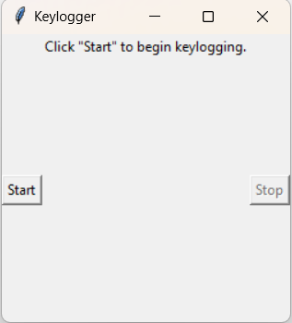
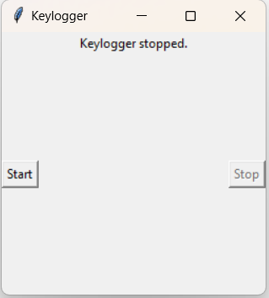
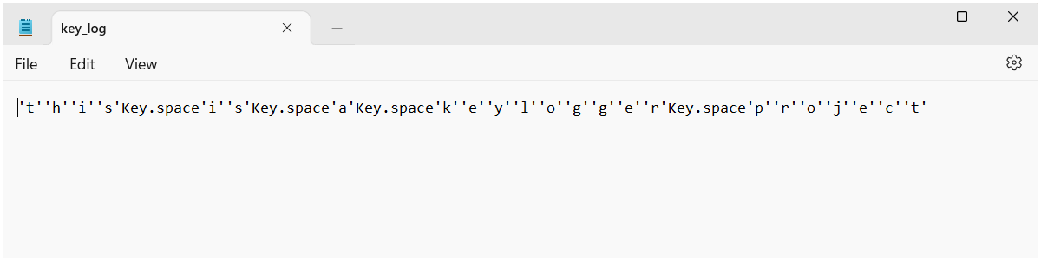
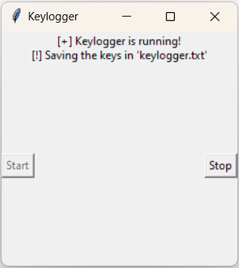
OUTPUT IMAGES

Slide 11
RESULTS
The advanced detection and removal tools successfully identified and eliminated keyloggers from user devices, reducing the incidence of data breaches
Educational programs increased user awareness and knowledge about keylogger threats, empowering individuals to adopt safer online practices.
Multi-factor authentication and encrypted communication, provided an additional layer of protection, making it more challenging for keyloggers to capture sensitive information.
Finally, The project significantly improved cybersecurity, protected user data, and encouraged a more security-conscious community.
3/21/2024 Annual Review
11

Slide 12
CONCLUSION
Keyloggers are a potent threat to both individuals and enterprises, with the potential to cause significant harm if left undetected.
Understanding the nature of keyloggers, their methods of infiltration, and the dangers they pose is crucial for maintaining a secure digital environment.
Have successfully created a python keylogger, recording keystrokes in a text file i.e., “keylogger.txt”.
So, we can this algorithm to track your keystrokes

Slide 13
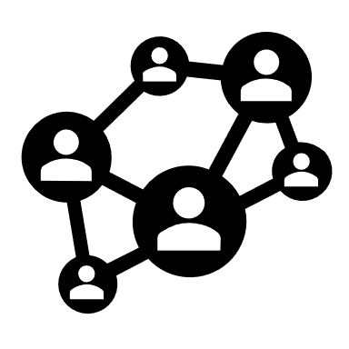
MY PROJECT LINK
https://github.com/DarkPheonix456/Gopichand.git

Slide 14
THANK YOU
-Gopichand Sujanmulk

